Slide 1
What does Swot bring to oceanography?
Cnes/Aviso
Notes:
Except otherwise noted, “What does Swot bring to oceanography?” presentation by Cnes/Aviso is licensed under CC BY-SA 4.0. To view a copy of this license, visit https://creativecommons.org/licenses/by-sa/4.0

Slide 2
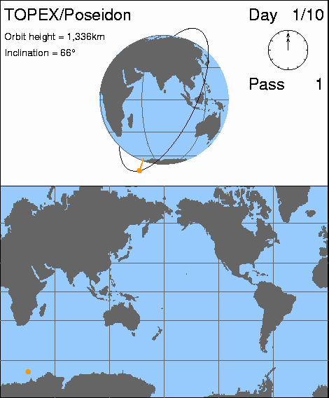
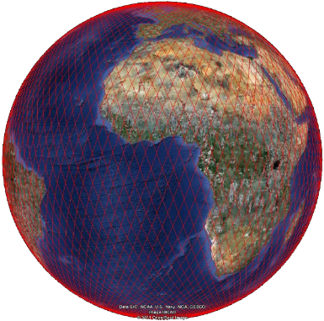
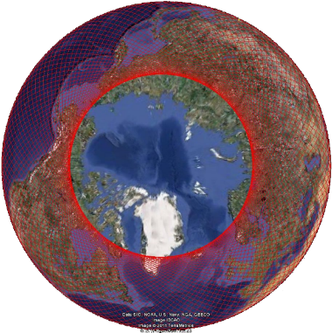
Before Swot
Altimetry before Swot has been providing Nadir measurement (i.e. just beneath the satellite)
NB. Nadir altimetry data = a narrow thread of measurements just beneath the satellite (aka “along-track” data)
Sentinel-6B coverage (formerly Topex/Poseidon, Jason-1, Jason-2, Jason-3 & Sentinel-6 Michael Freilich)
Courtesy CSIRO
Notes:
Except otherwise noted, “What does Swot bring to oceanography?” presentation by Cnes/Aviso is licensed under CC BY-SA 4.0. To view a copy of this license, visit https://creativecommons.org/licenses/by-sa/4.0

Slide 3
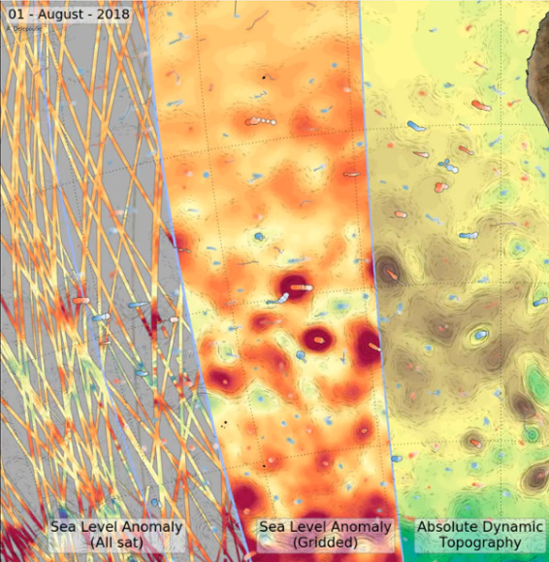
Before Swot
With these “along-track” measurements, 2D maps of sea surface heights can be reconstructed by combining several satellites.
But with limitations:
  The 2D mapping process means that small (< 100 km) or transient (< 10-15 day) ocean features are missed even when there are several satellites (even with 10 of them flying),
  Coastal and polar areas are complex to process (mix of water / land or ice-covered surfaces observed),
  Some of the satellites are not measuring at high latitudes (> 66°),
  Filtering are applied in the multi-mission data, which tends to smooth some features.
Notes:
> Figure Duacs
Except otherwise noted, “What does Swot bring to oceanography?” presentation by Cnes/Aviso is licensed under CC BY-SA 4.0. To view a copy of this license, visit https://creativecommons.org/licenses/by-sa/4.0

Slide 4
Before Swot, over the ocean
Global & regional sea level rise,
Global & regional ocean circulation (e.g.; ENSO monitoring),
Open ocean large mesoscale eddies (> 100 km in diameter)
(eg. operational oceanography),
Coastal measurements depending on the track vs coast geometry, and with dedicated processing,
Tides, surface and internal,
Geoid, Mean Sea Surface and bathymetry,
Significant wave heights and wind speed modulus under the track,
Polar seas (icebergs, ice leads and sea ice) & continental ice topography (depending on the satellite’s orbit).
Notes:
Except otherwise noted, “What does Swot bring to oceanography?” presentation by Cnes/Aviso is licensed under CC BY-SA 4.0. To view a copy of this license, visit https://creativecommons.org/licenses/by-sa/4.0

Slide 5
Swot over the ocean
Swot is observing the ocean surface heights in two dimensions
with 250 x 250 m native pixel over two ~60-km wide swaths (plus a classical nadir altimeter track in the middle) over the ocean.
Some very coastal areas are in the same resolution than the lands, i.e., up to a 10-m resolution.
with unprecedented good accuracy
What Swot is providing:
Fine-scale currents (10-100km) everywhere, but these scales dominate in coastal, regional and high-latitude seas
Representation of marine eddies at meso & submesoscale scale
High resolution global and coastal tides and internal tides
2D fine-scale images of surface waves, swell and winds
The stretching and straining of the surface flow that structures the surface temperature, freshwater and biomass distribution
Ocean Bathymetry
Notes:
Except otherwise noted, “What does Swot bring to oceanography?” presentation by Cnes/Aviso is licensed under CC BY-SA 4.0. To view a copy of this license, visit https://creativecommons.org/licenses/by-sa/4.0

Slide 6
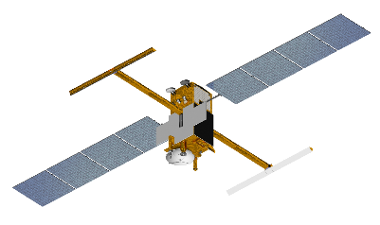
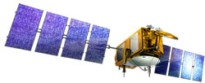

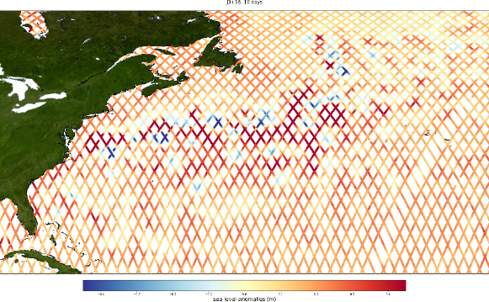
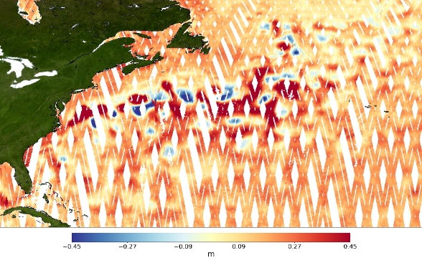
Classical altimetry vs Swot
Classical Nadir Altimetry (2 satellites, 10 days)
Swath Altimetry (10 days, i.e. ~half-cycle)
Credit Aviso
Notes:
Except otherwise noted, “What does Swot bring to oceanography?” presentation by Cnes/Aviso is licensed under CC BY-SA 4.0. To view a copy of this license, visit https://creativecommons.org/licenses/by-sa/4.0

Slide 7
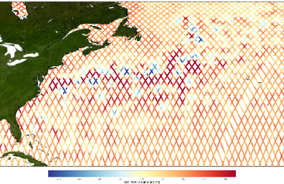
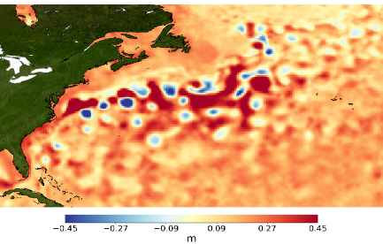
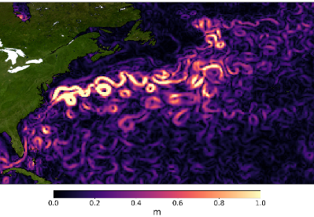

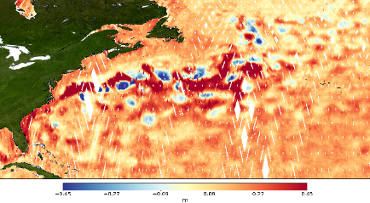
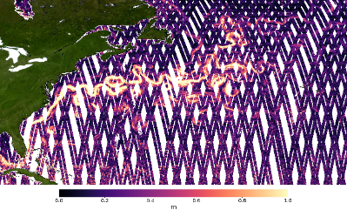
Classical altimetry vs Swot over the ocean in 10 days
Sea level anomalies from 10 days
Jason-3+Sentinel-6MF
Sea level anomaly grid computed
from 7 satellites
Velocities from the gridded data computed from 7 satellites
Sea level anomaly from 10 days of Swot
Sea level anomaly from a Swot cycle
Velocities from 10 days of Swot
Credit Aviso
Notes:
Except otherwise noted, “What does Swot bring to oceanography?” presentation by Cnes/Aviso is licensed under CC BY-SA 4.0. To view a copy of this license, visit https://creativecommons.org/licenses/by-sa/4.0

Slide 8
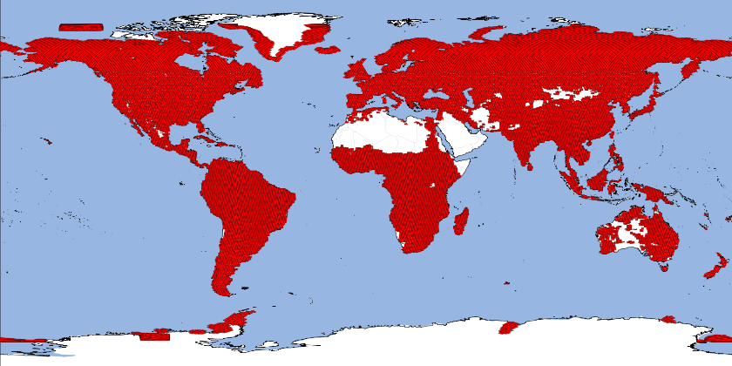
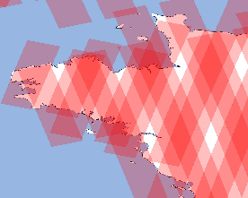
Low / High resolution coverage by Swot measurements
Swot in “high” resolution over inland waters (red areas on the map)
Measurements over the rest of the Earth are only in “low” resolution (higher than current basic altimetry data)
10-day sub-cycle with a complete coverage (full cycle 21 days)
Possibility of adjusting the HR mask up to 4 times per year (ex. for seasonal variations)
+ 4 patches of120x120 km² over ocean / sea-ice
A number of ocean coastal areas also in “high” resolution (e.g. over the West of France, left)
Notes:
Except otherwise noted, “What does Swot bring to oceanography?” presentation by Cnes/Aviso is licensed under CC BY-SA 4.0. To view a copy of this license, visit https://creativecommons.org/licenses/by-sa/4.0

Slide 9
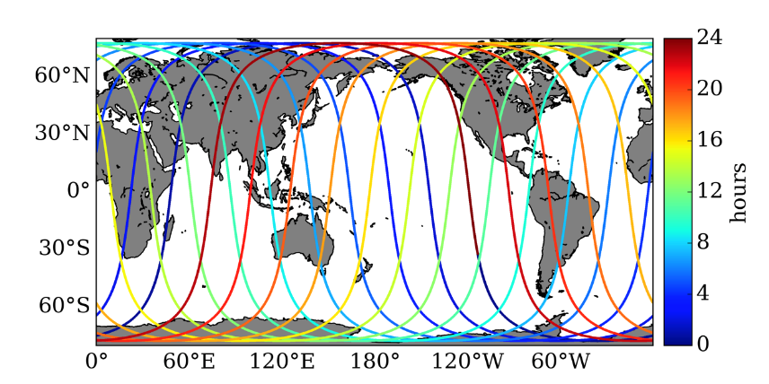
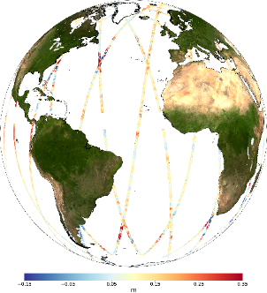
Two orbits for Swot: calval orbit
First 6 months (Dec. 2022-July 2023) : 1-day “calval” orbit
1st 3 months – instrument checkout (2022/12/16 → 2023/03/29) (almost no data generated / disseminated)
2nd 3 months – validation orbit (2023/03/29 → 2023/07/10; shift of ~14 h during the three months)
Ideal for ocean studies of rapidly evolving small mesoscales and submesoscales (but very sparce coverage)
Calibration & validation of
the measurements
Credit Aviso
Credit Swot-Adac
Notes:
Except otherwise noted, “What does Swot bring to oceanography?” presentation by Cnes/Aviso is licensed under CC BY-SA 4.0. To view a copy of this license, visit https://creativecommons.org/licenses/by-sa/4.0

Slide 10
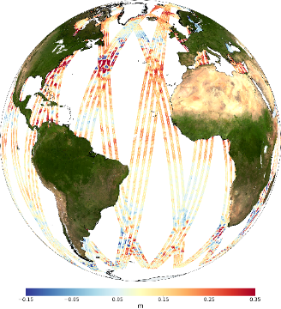
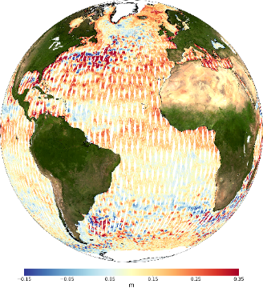
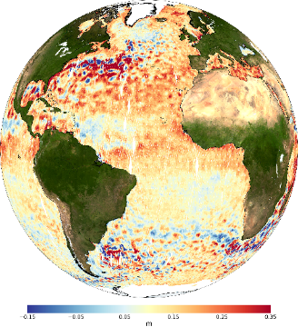
Two orbits for Swot: science orbit
21-day repeat “science” orbit
Nominally : 3-year
Full global coverage in 21 days, but:
  1-day and 10-day sub-cycles for better mesoscale coverage
  Swaths overlap at high latitudes, thus enabling even better/more frequent coverage there.
Orbit chosen to better observe coastal and internal tides (non-sun synchronous)
3 days
10 days
1 cycle
Credit Aviso
Notes:
Except otherwise noted, “What does Swot bring to oceanography?” presentation by Cnes/Aviso is licensed under CC BY-SA 4.0. To view a copy of this license, visit https://creativecommons.org/licenses/by-sa/4.0

Slide 11
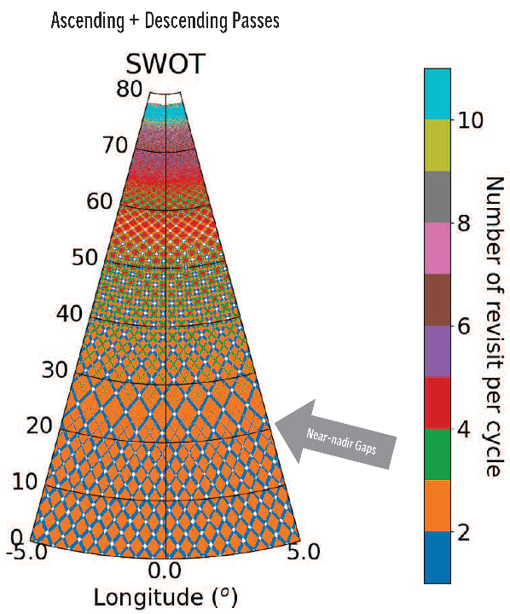
Revisit
Swot science orbit is 21-day long, but swathes are overlapping each other, thus providing most areas with more than one observation per cycle
Roughly, the number of revisits increase with latitude
Number of “revisits” of Swot swath measurements during the 21-day cycle, i.e., the number of times KaRIn swath will cover any given area, depending on the latitude (here only the positive latitudes are shown, South latitudes mirror them). E.g., at 45°N, you have mostly between 2 (orange) and 3 (dark green) observations, with a few areas with only 1 (dark blue) or up to 4 (red) observations. Some “near nadir gaps” (in white) exist, never observed. (Credit Cnes)

Slide 12
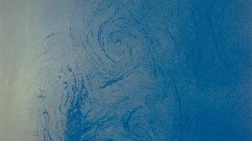
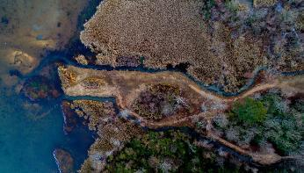
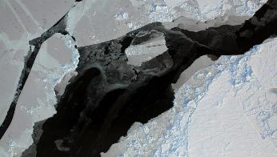
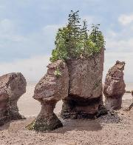
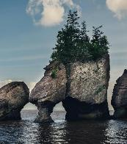
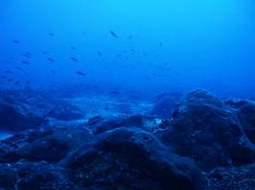
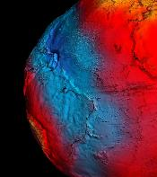
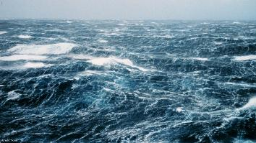
Swot applications over the ocean
2D surface height images for …
Astronaut photo STS41G Nasa
Nathan Anderson for Unsplash
Credit Nasa, operation ice bridge
  Ocean circulation features of more than 7 km (meso- & submeso- scale)
Coastal/estuarine SSH & currents
High-latitude Currents in leads & Sea Ice Freeboard
Ruben Ortega for Unsplash
Peter Lloyd for Unsplash
Crédit Noaa
Crédit ESA
Crédit Noaa
Tides, Coastal (but not only) & Internal Tides / Internal waves
High-resolution open ocean geoid & Bathymetry
High-resolution open ocean geoid & Bathymetry
Notes:
Except otherwise noted, “What does Swot bring to oceanography?” presentation by Cnes/Aviso is licensed under CC BY-SA 4.0. To view a copy of this license, visit https://creativecommons.org/licenses/by-sa/4.0

Slide 13
2D surface height images for …
Meso- & submeso- scale ocean SSH & currents
Notes:
Astronaut photo STS41G Nasa https://eol.jsc.nasa.gov/
Except otherwise noted, “What does Swot bring to oceanography?” presentation by Cnes/Aviso is licensed under CC BY-SA 4.0. To view a copy of this license, visit https://creativecommons.org/licenses/by-sa/4.0

Slide 14
Meso- & submeso- scale ocean SSH & currents
The typical radius of mesoscale eddies varies, ranging from 10 km at high latitude and in regional seas, to 300 km in the tropics. With nadir altimetry, we were missing the smaller mesoscales (under 100 km).
Mesoscale: transient dynamics (medium-zero over times > 1 year) and dominated by geostrophic equilibrium.
Typically, eddies between the Rossby radius (10-100km) and a few 100s of km.
Submesoscale: transient dynamics, in which geostrophic equilibrium is important, but not dominant.
Typically eddies and filaments 1-10s km
Notes:
Except otherwise noted, “What does Swot bring to oceanography?” presentation by Cnes/Aviso is licensed under CC BY-SA 4.0. To view a copy of this license, visit https://creativecommons.org/licenses/by-sa/4.0

Slide 15
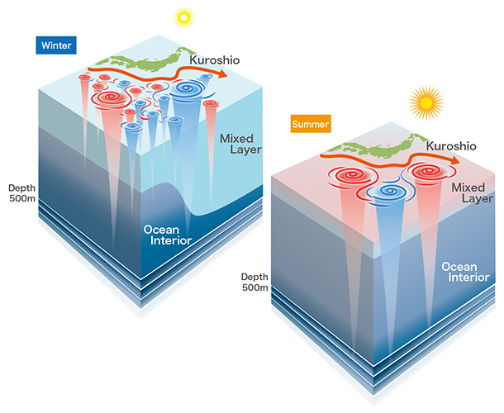
2D surface height images for …
Meso & sub-mesoscale ocean SSH & currents
The first high-precision altimeters showed that eddies & mesoscale circulation > 100 km are ubiquitous in the ocean, not “only” a few turbulent regions in the major currents.
Other techniques showed that these features are not the smallest
In mid-latitudes, winter has more energetic smaller-scale features than in summer,
these smaller-scales contribute 50 % of the vertical transport (mixing heat, carbon, nutrients, all these with implications on climate)
(Credits Jamstec)
(Sub) mesoscale Fronts & eddies
Notes:
mesoscale and submesoscale circulation at spatial resolutions of 15 km and larger
In winter, the mixed layer becomes thicker because of cooling of the ocean surface (left). On the other hand the mixed layer depth is shallow in summer due to calm winds and stronger solar radiation (right). Submesoscale structures become more active within the deeper mixed layer in winter (left), while becoming calmer in summer when the mixed layer is shallow (right).
This mixing is of foremost importance to understand the vertical heat, freshwater and carbon exchanges, all of which having an importance in climate studies
Except otherwise noted, “What does Swot bring to oceanography?” presentation by Cnes/Aviso is licensed under CC BY-SA 4.0. To view a copy of this license, visit https://creativecommons.org/licenses/by-sa/4.0

Slide 16
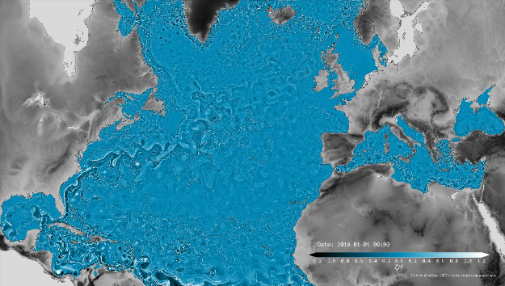
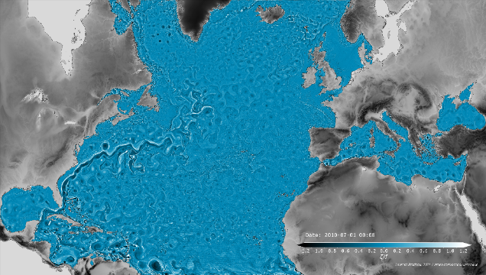
Seasonal structuration of the ocean submesocale
Winter
Modelled hourly-mean snapshots of the surface relative vorticity on the 1st of January and on the 1st of July 2010 from a 1/60° model (eNATL60)
Summer
© L. Brodeau, Ocean-Next / IGE
Structures are smaller in winter than in summer
© L. Brodeau, Ocean-Next / IGE
Notes:
Except otherwise noted, “What does Swot bring to oceanography?” presentation by Cnes/Aviso is licensed under CC BY-SA 4.0. To view a copy of this license, visit https://creativecommons.org/licenses/by-sa/4.0

Slide 17
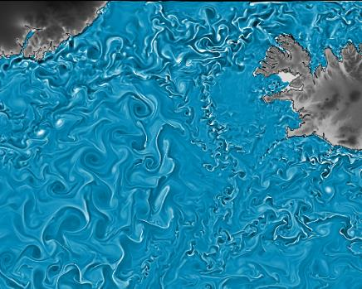
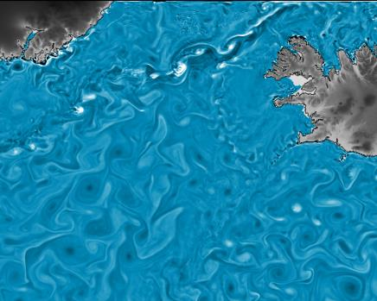

Seasonal structuration of the ocean submesocale
Winter
Summer
© L. Brodeau, Ocean-Next / IGE
© L. Brodeau, Ocean-Next / IGE
2010-01-01
2010-07-01
Modelled hourly-mean snapshots of the surface relative vorticity on the 1st of January and on the 1st of July 2010
from a 1/60° model (eNATL60)
Structures are smaller in winter than in summer
Notes:
Except otherwise noted, “What does Swot bring to oceanography?” presentation by Cnes/Aviso is licensed under CC BY-SA 4.0. To view a copy of this license, visit https://creativecommons.org/licenses/by-sa/4.0

Slide 18
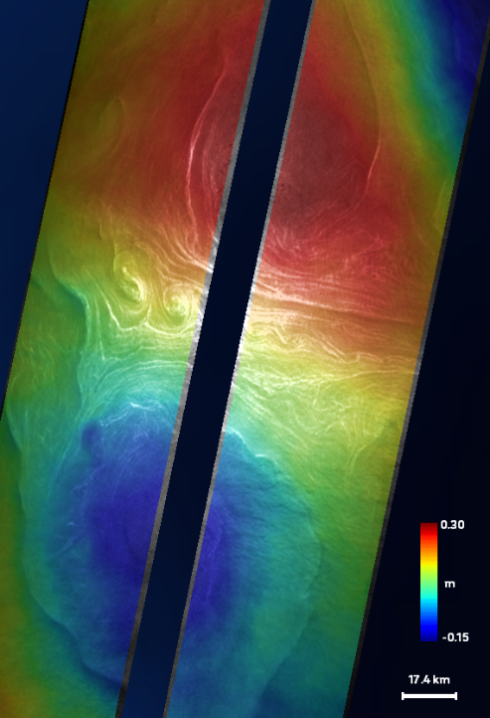
(Sub)mesoscale circulation
Mesoscale eddies are ubiquitous in the oceans.
Swot is observing eddies in two dimensions under its two swathes, thus enabling direct observations of their amplitude and shape.
Smaller eddies & front structures are also visible.
Swot backscatter (sigma0) superimposed on sea surface height anomalies (colors) at 250 m, on June 10, 2023 (cycle 548, track 9), over the Gulf Stream off the East coast of North America. The two larger eddies, one cyclonic (red), the other anticyclonic (blue), are about 100 km in diameter (the total width of the Swot swaths is 120 km across), while the much smaller structures seen in the backscatter are of the order of magnitude of a few kilometers (Credit ODL/Cnes).
Notes:
Topography as observed by KaRIn during the 1-day calval phase
Except otherwise noted, “What does Swot bring to oceanography?” presentation by Cnes/Aviso is licensed under CC BY-SA 4.0. To view a copy of this license, visit https://creativecommons.org/licenses/by-sa/4.0

Slide 19
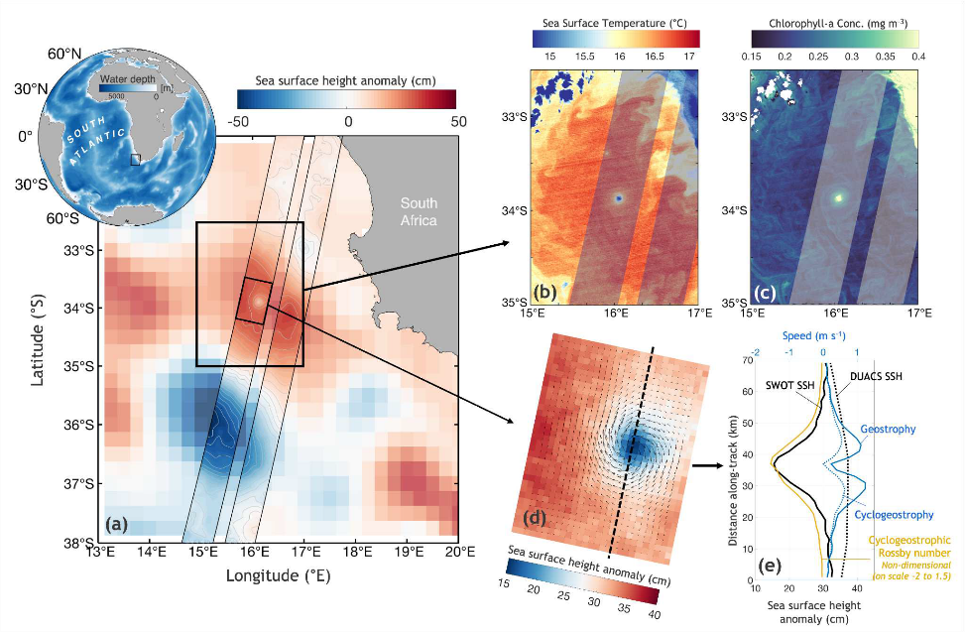
Multi-sensor comparison: independent confirmation
Swot SSH (superimposed on multimission gridded SSH (Duacs)), showing a submesoscale eddy off South Africa in the Atlantic Ocean, with a radius of about 15 km but an amplitude of 15 cm on August 2, 2023 (black boxes; gray/white contours denote Swot SSH). The eddy is also visible in sea surface temperature (b), and chlorophyll-A (c) satellite measurements. (d), a zoom in on the left Swot swath, showing SSH and velocity vectors computed by assuming geostrophy (from which the eddy seems to deviate, in fact). (from [Archer et al., 2024], Credit JPL)
Notes:
Except otherwise noted, “What does Swot bring to oceanography?” presentation by Cnes/Aviso is licensed under CC BY-SA 4.0. To view a copy of this license, visit https://creativecommons.org/licenses/by-sa/4.0
Matthew Archer, Jinbo Wang, Patrice Klein et al. Global Submesoscale Ocean Dynamics Unveiled by Wide-Swath Satellite Altimetry, 07 October 2024, Preprint (Version 1) available at Research Square [https://doi.org/10.21203/rs.3.rs-5177358/v1] ; under review at Nature Portfolio. licensed under a CC BY 4.0 License

Slide 20
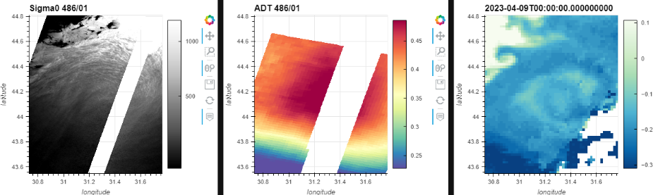
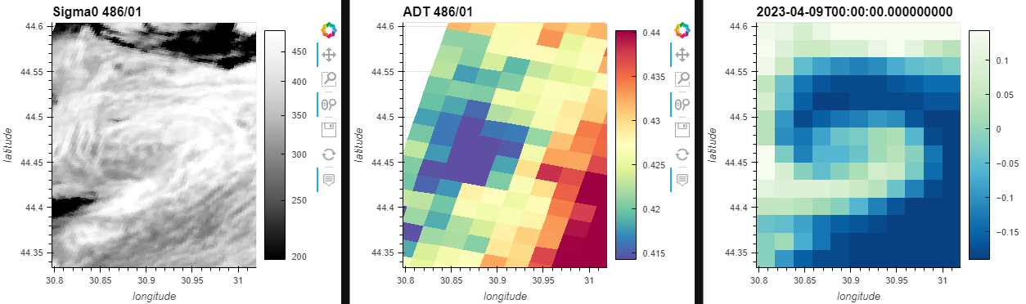
From large to submesoscale, SSH & roughness
100 km mesoscale eddy
10 km submesoscale
Swot 2D-surface roughness (Sigma0) varies across large and small ocean dynamics
Credit Cnes
Notes:
Except otherwise noted, “What does Swot bring to oceanography?” presentation by Cnes/Aviso is licensed under CC BY-SA 4.0. To view a copy of this license, visit https://creativecommons.org/licenses/by-sa/4.0

Slide 21
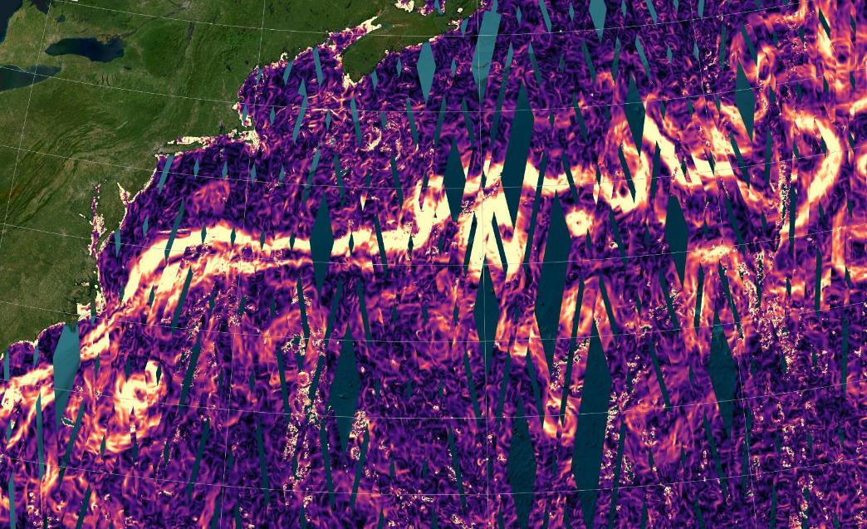
Gulf Stream mesoscale turbulences from KaRIn
Credit Aviso
Notes:
Except otherwise noted, “What does Swot bring to oceanography?” presentation by Cnes/Aviso is licensed under CC BY-SA 4.0. To view a copy of this license, visit https://creativecommons.org/licenses/by-sa/4.0

Slide 22
Coastal/estuarine SSH & currents
Notes:
Except otherwise noted, “What does Swot bring to oceanography?” presentation by Cnes/Aviso is licensed under CC BY-SA 4.0. To view a copy of this license, visit https://creativecommons.org/licenses/by-sa/4.0

Slide 23
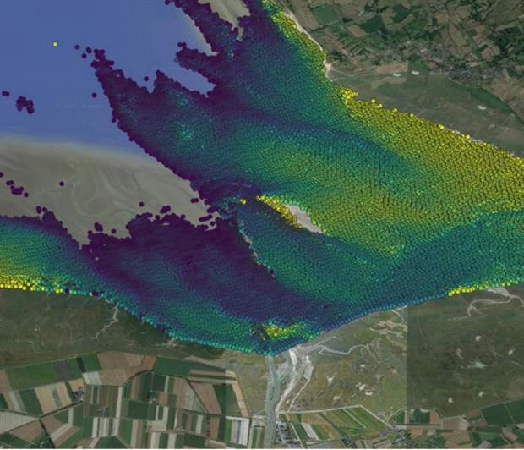
Coastal/estuarine
One of the most expected Swot output is the ability to measure very near the coasts in high resolution and in 2D.
Here the topography of the bottom of the bay of Mont St Michel is visible from Swot measurements at low tide (it then measures wet sand topography), from high-resolution data.
Heights measured by SWOT in the Bay of Mont Saint Michel on 2023/11/24 (cycle 7) over wet sand at low tide, corresponding mostly to the relief of the bay floor. There is a difference of 4 meters between the areas in dark blue and those in yellow. The circled area corresponds to the Mont itself (Credit Cnes, 2024)
Notes:
Except otherwise noted, “What does Swot bring to oceanography?” presentation by Cnes/Aviso is licensed under CC BY-SA 4.0. To view a copy of this license, visit https://creativecommons.org/licenses/by-sa/4.0

Slide 24
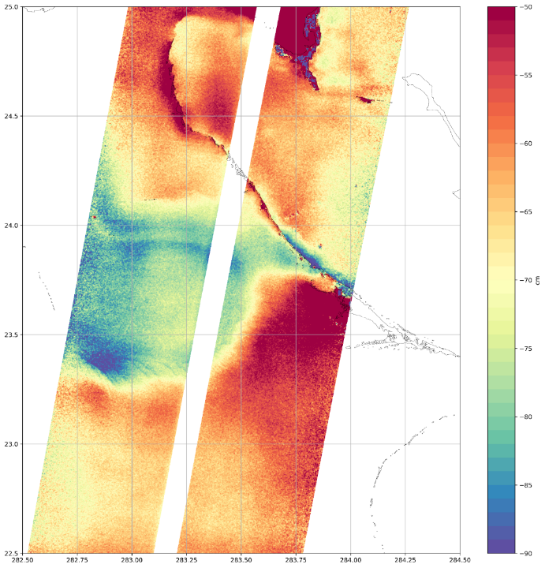
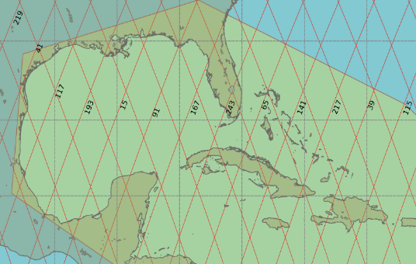
Caribbean topography
Atlantique
Floride
Cuba
Mexique
Jason tracks in red
  Features from 10 to 100 km
  Great consistency with shorelines and bathymetry and very consistent with the 1D nadir altimeter
  Extremely sharp gradients over a few km
  250 m resolution yields SSHA content up to the coast
KaRIn topography (250 m)
Credit Cnes
Notes:
Except otherwise noted, “What does Swot bring to oceanography?” presentation by Cnes/Aviso is licensed under CC BY-SA 4.0. To view a copy of this license, visit https://creativecommons.org/licenses/by-sa/4.0

Slide 25
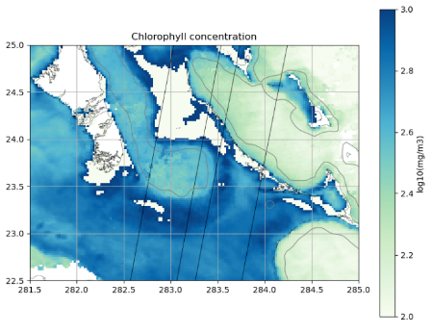
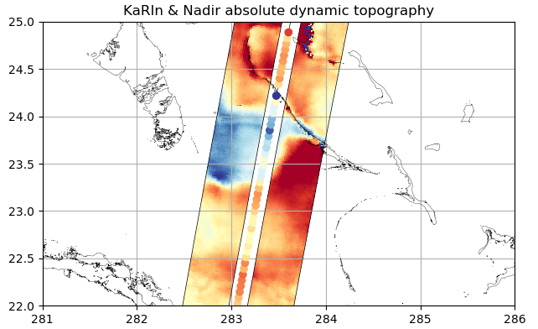

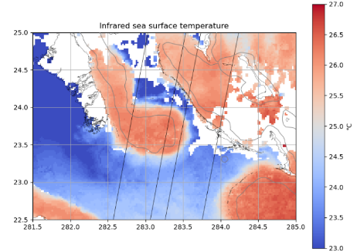
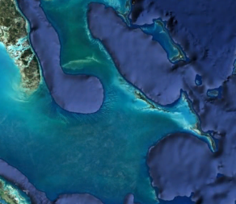
Comparison with bathymetry, SST, ocean color
  Overall consistency with SST and Ocean Color is amazing at scales of the order of 10 to 50 km
Bathymetry & Optical (Landsat & Sentinel-2)
Credit Cnes
Notes:
Except otherwise noted, “What does Swot bring to oceanography?” presentation by Cnes/Aviso is licensed under CC BY-SA 4.0. To view a copy of this license, visit https://creativecommons.org/licenses/by-sa/4.0

Slide 26
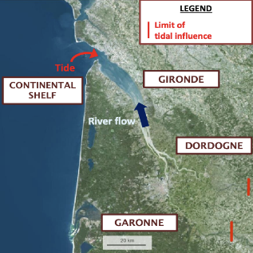
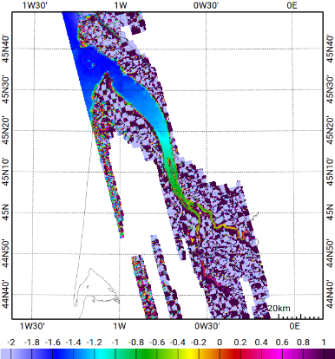
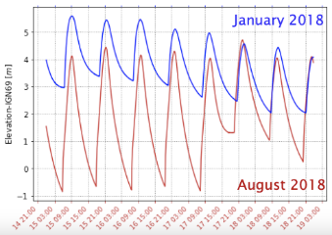
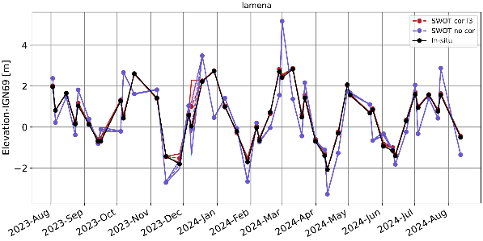
Gironde estuary (France)
Largest estuary in Western Europe
Interaction tides & river discharge : difficult to observe and predict non-stationary tides
Swot provides 2D evolution of tides in the estuary
Swot corrected data are very close to in-situ tide gauge data
SSH wrt geoid [m]
Credit Legos, Courtesy L. Caubet, 2024
Notes:
Except otherwise noted, “What does Swot bring to oceanography?” presentation by Cnes/Aviso is licensed under CC BY-SA 4.0. To view a copy of this license, visit https://creativecommons.org/licenses/by-sa/4.0

Slide 27
High-latitude Currents in leads & Sea Ice Freeboard
Notes:
Except otherwise noted, “What does Swot bring to oceanography?” presentation by Cnes/Aviso is licensed under CC BY-SA 4.0. To view a copy of this license, visit https://creativecommons.org/licenses/by-sa/4.0

Slide 28


Sea-ice thickness in 2D
  250-m products in polar regions: sea-ice topography and ocean topography in ice leads (2D sea-ice thickness)
  Locations and shapes of smaller icebergs are confirmed by Sentinel-1 (moved by ocean currents every day)
  Swot’s Ka-band bridges the gap between Saral and Cristal (also complements Sentinel-3)
Black & White: Sentinel-1
(one day lag)
Colour: KaRIn topography
(250m, blue is high, red is low)
Credit Cnes
Notes:
Except otherwise noted, “What does Swot bring to oceanography?” presentation by Cnes/Aviso is licensed under CC BY-SA 4.0. To view a copy of this license, visit https://creativecommons.org/licenses/by-sa/4.0

Slide 29

Ice leads
Credit Cnes
Notes:
Except otherwise noted, “What does Swot bring to oceanography?” presentation by Cnes/Aviso is licensed under CC BY-SA 4.0. To view a copy of this license, visit https://creativecommons.org/licenses/by-sa/4.0

Slide 30

The “A-76” iceberg
Detached from Filchner-Ronne Ice Shelf in 2021 into the Weddell Sea
Moved to the Antarctic Circumpolar Current
splitted close to South Georgia in 2023
Visible on Swot data (backscatter, i.e. surface roughness, right)
Credit Cnes/CLS
Notes:
Except otherwise noted, “What does Swot bring to oceanography?” presentation by Cnes/Aviso is licensed under CC BY-SA 4.0. To view a copy of this license, visit https://creativecommons.org/licenses/by-sa/4.0

Slide 31







Iceberg A-23a
broke off from the Filchner-Ronne Ice Shelf in 1986,
started moving again in 2020
broke away from the sea ice around Antarctica in Sept. 2023
The reflected power data represent the iceberg as a black (i.e. not reflecting the radar beam back to the altimeter antennas) surface.
Credit Cnes/CLS
Notes:
Sea level anomalies on 2023/11/16, showing the general shape of A-23a, but with low values: the iceberg is so high that KaRIn’s standard ocean processing misinterpret the measurement as a "lower than average" height. It also shows a number of artifacts. A dedicated sea-ice/icebergs processing would be needed to reflect the real height of such tabular mega-icebergs in particular, and of sea ice in general (credit Cnes/CLS/JPL)
Except otherwise noted, “What does Swot bring to oceanography?” presentation by Cnes/Aviso is licensed under CC BY-SA 4.0. To view a copy of this license, visit https://creativecommons.org/licenses/by-sa/4.0

Slide 32


10 days of KaRIn topography over the Southern Ocean and sea-ice
(no interpolation, no smoothing)
Credit Cnes/CLS
Notes:
Except otherwise noted, “What does Swot bring to oceanography?” presentation by Cnes/Aviso is licensed under CC BY-SA 4.0. To view a copy of this license, visit https://creativecommons.org/licenses/by-sa/4.0

Slide 33

KaRIN backscatter (dB)
KaRIN topography (cm)
Credit Cnes/CLS
Notes:
Except otherwise noted, “What does Swot bring to oceanography?” presentation by Cnes/Aviso is licensed under CC BY-SA 4.0. To view a copy of this license, visit https://creativecommons.org/licenses/by-sa/4.0

Slide 34
Coastal, high latitude tides
Notes:
Except otherwise noted, “What does Swot bring to oceanography?” presentation by Cnes/Aviso is licensed under CC BY-SA 4.0. To view a copy of this license, visit https://creativecommons.org/licenses/by-sa/4.0

Slide 35
Swot & the tides
Swot is measuring full swathes of sea surface height, even very close to the coasts, including within estuaries, and even in rivers.
Such 2D-tide measurements had never been available (only model outputs were)
This will enable to better model the tides in two dimensions, even in very narrow channels (fjords, rivers). This can be helpful for navigation.
Notes:
Except otherwise noted, “What does Swot bring to oceanography?” presentation by Cnes/Aviso is licensed under CC BY-SA 4.0. To view a copy of this license, visit https://creativecommons.org/licenses/by-sa/4.0

Slide 36


Coastal tides (Mont St Michel Bay, France)
Swot data are available in High Resolution (hydrology data) along coasts.
Depending on the tide, one can see the bottom (sand, silt…) or the surface water height.
Swot height measurements at low tide (top, the wet sand reflects the radar signal), and high tide (~12 m in tide timetables, right) over the Mont St Michel Bay, France.
(credit Cnes/Aviso, background image Sentinel-2)
Notes:
Except otherwise noted, “What does Swot bring to oceanography?” presentation by Cnes/Aviso is licensed under CC BY-SA 4.0. To view a copy of this license, visit https://creativecommons.org/licenses/by-sa/4.0

Slide 37

Tides in estuaries (Severn estuary, England)
  A Situation map, with the Severn estuary shown in the red square, with Swot swath mapped (1-day orbit) .
  Snapshots of Swot Sea Level Anomalies data taken at low (B) and high (C) tide periods. (Credit Tech. U. Munich, courtesy M. Hart-Davis)
Notes:
Except otherwise noted, “What does Swot bring to oceanography?” presentation by Cnes/Aviso is licensed under CC BY-SA 4.0. To view a copy of this license, visit https://creativecommons.org/licenses/by-sa/4.0

Slide 38

Tides in estuaries (Severn estuary, England)
Amplitude and Phase of the Solar tidal semi-diurnal component S2, computed from Swot measurements. (Credit Tech. U. Munich, courtesy M. Hart-Davis)
Tidal components can be extracted from Swot measured water surface heights, (including solar components, since the orbits are non-sunsynchronous (thus not phased with the tides main frequencies))
Notes:
Except otherwise noted, “What does Swot bring to oceanography?” presentation by Cnes/Aviso is licensed under CC BY-SA 4.0. To view a copy of this license, visit https://creativecommons.org/licenses/by-sa/4.0

Slide 39


Tides in rivers (Elbe, Germany & Congo)
  Amplitude and Phase of the Lunar tidal semi-diurnal component M2, computed from Swot measurements, left over the Elbe river (Germany) and right Congo River (between Congo and Democratic Republic of the Congo). (Credit Tech. U. Munich, courtesy M. Hart-Davis)
Notes:
Except otherwise noted, “What does Swot bring to oceanography?” presentation by Cnes/Aviso is licensed under CC BY-SA 4.0. To view a copy of this license, visit https://creativecommons.org/licenses/by-sa/4.0

Slide 40


High-latitude tides (fjords): Sognefjorden
  Semi-diurnal (M2) tide amplitudes (A) and phase lag (B) derived Swot data within the Sognefjorden. (High-resolution “hydrology” data)
  (Credit Tech. U. Munich, courtesy M. Hart-Davis)
Notes:
Except otherwise noted, “What does Swot bring to oceanography?” presentation by Cnes/Aviso is licensed under CC BY-SA 4.0. To view a copy of this license, visit https://creativecommons.org/licenses/by-sa/4.0

Slide 41
Internal Tides / Internal waves
Notes:
Except otherwise noted, “What does Swot bring to oceanography?” presentation by Cnes/Aviso is licensed under CC BY-SA 4.0. To view a copy of this license, visit https://creativecommons.org/licenses/by-sa/4.0

Slide 42
Internal tides
Internal tides are tidal waves created by the bottom topography. They propagate at the interfaces between ocean layers.
Swot is observing the propagation of internal tides in 2D
important for ocean mixing & energy dissipation
And Swot SSH needs to be corrected from them, too, for (sub)mesoscale studies
~2 cm
~20 m
Notes:
https://www.youtube.com/watch?v=WYmRnSRsS7Y
Except otherwise noted, “What does Swot bring to oceanography?” presentation by Cnes/Aviso is licensed under CC BY-SA 4.0. To view a copy of this license, visit https://creativecommons.org/licenses/by-sa/4.0

Slide 43



Internal tides traveling eastwards in the Indian Ocean
Mascarene
Plateau
Mascarene
Basin
Credit Cnes/CLS
Notes:
Except otherwise noted, “What does Swot bring to oceanography?” presentation by Cnes/Aviso is licensed under CC BY-SA 4.0. To view a copy of this license, visit https://creativecommons.org/licenses/by-sa/4.0

Slide 44

Internal tides & ship detection in the Gibraltar Strait
Credit JPL, Courtesy M. Archer
Notes:
Except otherwise noted, “What does Swot bring to oceanography?” presentation by Cnes/Aviso is licensed under CC BY-SA 4.0. To view a copy of this license, visit https://creativecommons.org/licenses/by-sa/4.0

Slide 45
High-resolution open ocean geoid & bathymetry
Notes:
Except otherwise noted, “What Swot is bringing to oceanography?” presentation by Cnes/Aviso is licensed under CC BY-SA 4.0. To view a copy of this license, visit https://creativecommons.org/licenses/by-sa/4.0

Slide 46


High-resolution open ocean geoid & bathymetry
Mean sea surface reflects mostly Earth gravity field (geoid) (also the Mean Dynamic Topography)
The latter depends on mantel inhomogeneities but also on ocean floor reliefs (bathymetry)
Credit Cnes/CLS
H (m)
Mean Sea Surface (current version from nadir altimetry, with geoid over the continents)
Notes:
Except otherwise noted, “What does Swot bring to oceanography?” presentation by Cnes/Aviso is licensed under CC BY-SA 4.0. To view a copy of this license, visit https://creativecommons.org/licenses/by-sa/4.0

Slide 47
Bathymetry: a new perspective
Only 25% of the global seafloor has been mapped by ships. Marine gravity from satellite altimetry provides low resolution maps in the gaps.
Seafloor features not well resolved by nadir altimeters include: abyssal hills, small seamounts, and continental margin structure.
Swot has dramatically improved accuracy and resolution to better map these small-scale structures.
Notes:
Except otherwise noted, “What does Swot bring to oceanography?” presentation by Cnes/Aviso is licensed under CC BY-SA 4.0. To view a copy of this license, visit https://creativecommons.org/licenses/by-sa/4.0

Slide 48

Seamounts
Abyssal hills
Continental
margin
Credit Scripps Institution of Oceanography, courtesy Y. Yu & D. Sandwell
Notes:
The marine vertical gravity gradient uses the global VGG from previous nadir altimeters in a remove/restore method. At this scale the SWOT VGG looks like the previous VGG from nadir altimetry. However, SWOT provides much higher resolution as we show next in the three boxed areas.
Except otherwise noted, “What does Swot bring to oceanography?” presentation by Cnes/Aviso is licensed under CC BY-SA 4.0. To view a copy of this license, visit https://creativecommons.org/licenses/by-sa/4.0

Slide 49

Bathymetry: new seamounts discovered
Credit Scripps Institution of Oceanography, courtesy Y. Yu & D. Sandwell
Notes:
Except otherwise noted, “What does Swot bring to oceanography?” presentation by Cnes/Aviso is licensed under CC BY-SA 4.0. To view a copy of this license, visit https://creativecommons.org/licenses/by-sa/4.0

Slide 50

Bathymetry: abyssal hills
Prior to SWOT, abyssal hills were only mapped using multibeam sonar. Now they are visible almost everywhere in the ocean basins.
Abyssal are the most common landform on Earth.
They form at seafloor spreading ridges (shown in black lines) and thus reveal past plate tectonics.
Deep tidal currents flowing over rough abyssal hill produce internal waves, especially along rough slow spreading ridges.
Credit Scripps Institution of Oceanography, courtesy Y. Yu & D. Sandwell
Notes:
Except otherwise noted, “What does Swot bring to oceanography?” presentation by Cnes/Aviso is licensed under CC BY-SA 4.0. To view a copy of this license, visit https://creativecommons.org/licenses/by-sa/4.0

Slide 51

Bathymetry: continental margin structures
This continental margin
is mostly flat seafloor in areas shallower than 1000 m so the Vertical Gravity Grandient reveals basement structure not resolved before SWOT.
The continental slope,
right of the 1000 m contour is incised by
river channels carrying
sediment to the deep Argentine basin. These features are now resolved globally including the Antarctic margins.
Credit Scripps Institution of Oceanography, courtesy Y. Yu & D. Sandwell
Notes:
Except otherwise noted, “What does Swot bring to oceanography?” presentation by Cnes/Aviso is licensed under CC BY-SA 4.0. To view a copy of this license, visit https://creativecommons.org/licenses/by-sa/4.0

Slide 52
Measuring Significant
Wave Heights & swell
Notes:
Except otherwise noted, “What does Swot bring to oceanography?” presentation by Cnes/Aviso is licensed under CC BY-SA 4.0. To view a copy of this license, visit https://creativecommons.org/licenses/by-sa/4.0

Slide 53

Significant wave heights
As all altimeters, albeit following different physical principles, Swot is estimating the Significant wave heights over its swaths.
The measurement principle and the use of the Ka band may limit the amount of usable data in the event of a severe storm/cyclone.
Significant wave heights from all nadir altimeters (lines) and from Swot on 2024/09/26 (hurricane Helene, trajectory in dots colored by wind speed). (Credit Aviso)
Notes:
Except otherwise noted, “What does Swot bring to oceanography?” presentation by Cnes/Aviso is licensed under CC BY-SA 4.0. To view a copy of this license, visit https://creativecommons.org/licenses/by-sa/4.0

Slide 54

Swell in 250-m product
Storm-generated long-wavelength swells are clearly seen in KaRIn Sea Surface Height, even those with amplitude as small as 3 cm
KaRIn can be used to determine swells’ properties, and to detect them over the whole ocean
Sea level variations, in shades of blue, along Swot Swath ground track, measured by KaRIn, showing the swell over three different 40x40 km areas around Australia (locations on map below) (from [Ardhuin et al., 2024])
Notes:
Except otherwise noted, “What does Swot bring to oceanography?” presentation by Cnes/Aviso is licensed under CC BY-SA 4.0. To view a copy of this license, visit https://creativecommons.org/licenses/by-sa/4.0

Slide 55




Occasional circular waves near icebergs
(mini-tsunamis as the iceberg capsizes, see https://doi.org/10.3189/172756411797252103 )
Credit Cnes/CLS
Topography (cm)
Relative sigma0
Notes:
Except otherwise noted, “What does Swot bring to oceanography?” presentation by Cnes/Aviso is licensed under CC BY-SA 4.0. To view a copy of this license, visit https://creativecommons.org/licenses/by-sa/4.0

Slide 56


An earthquake-generated tsunami wave in 2 dimensions
On May 19, an earthquake occurred in Equatorial Pacific
The tsunami was observed by SWOT a few hours later (for the first time in 2 dimensions, i.e. wave direction and amplitude). The tsunami wave front observed in the KaRIn image is consistent (but not perfectly aligned) with model predictions)
epicenter
Snapshot from GNS Science model
https://www.youtube.com/watch?v=NetSgSbpotc&t=3s
Credit Cnes/CLS
KaRIn topography (cm) c525/p17
Notes:
Except otherwise noted, “What does Swot bring to oceanography?” presentation by Cnes/Aviso is licensed under CC BY-SA 4.0. To view a copy of this license, visit https://creativecommons.org/licenses/by-sa/4.0

Slide 57



A tsunami within a fjord
Swot observed long-lived seiche waves from a landslide in a fjord, which provoked a 9-day-long, global seismic signal
(from [Monahan et al., 2025])
Notes:
Except otherwise noted, “What does Swot bring to oceanography?” presentation by Cnes/Aviso is licensed under CC BY-SA 4.0. To view a copy of this license, visit https://creativecommons.org/licenses/by-sa/4.0

Slide 58
Other
Notes:
Except otherwise noted, “What does Swot bring to oceanography?” presentation by Cnes/Aviso is licensed under CC BY-SA 4.0. To view a copy of this license, visit https://creativecommons.org/licenses/by-sa/4.0

Slide 59

Sargassum Algae
KaRIN 250-m Sigma0 (Ka-band surface roughness, mainly from from wind & wave)
Black regions are rain events
Red polygons are confirmed Sargassum from Sentinel-3 OLCI sensor when it’s available (OLCI does not work in the presence of clouds, but Swot does)
The surface roughness is changed in the presence of Sargassum at/near the surface, creating whiter regions in backscatter image (in calm atmosphere/wave conditions)
Sargassum patches are moved by ocean currents
(approx. 1 h between the OLCI and Swot images)
Credit Cnes/CLS
Notes:
Except otherwise noted, “What does Swot bring to oceanography?” presentation by Cnes/Aviso is licensed under CC BY-SA 4.0. To view a copy of this license, visit https://creativecommons.org/licenses/by-sa/4.0

Slide 60



Ships in KaRIn images
  Ships are visible in some Swot images
  Automated Identification System tracking (black dots below) matches the very bright pixel in the backscatter image (white dot): the ship was flashed by KaRIn
  Expected to happen for very large ships (and icebergs)
  Systematic co-locations will tell how frequently it happens.
Culprit for the red pixel? Pegasus Star
(oil tanker, 250m long, 6.5m freeboard)
Credit Cnes
Notes:
Except otherwise noted, “What does Swot bring to oceanography?” presentation by Cnes/Aviso is licensed under CC BY-SA 4.0. To view a copy of this license, visit https://creativecommons.org/licenses/by-sa/4.0

Slide 61




Slicks on the ocean
(dark in Sentinel-1 images, white in KaRIn’s)
Sentinel-1 NRCS (8h later)
Sentinel-1 NRCS (8h later)
KaRIn 250m backscatter
Credit Cnes
Notes:
Except otherwise noted, “What does Swot bring to oceanography?” presentation by Cnes/Aviso is licensed under CC BY-SA 4.0. To view a copy of this license, visit https://creativecommons.org/licenses/by-sa/4.0

Slide 62
Overview of ocean data & contents
Notes:
Except otherwise noted, “What does Swot bring to oceanography?” presentation by Cnes/Aviso is licensed under CC BY-SA 4.0. To view a copy of this license, visit https://creativecommons.org/licenses/by-sa/4.0

Slide 63

Level-2 data: 2-km data grid over ocean (basic & expert)
Credit Aviso
Swot KaRIn SSHA data over the Gulf Stream area plotted with squares materializing the data pixels (abscissa and ordinates in indexes). More fields available in “Expert” data than in “Basic” ones
(note that the nadir data are available independently at L2 level)
Notes:
Except otherwise noted, “What does Swot bring to oceanography?” presentation by Cnes/Aviso is licensed under CC BY-SA 4.0. To view a copy of this license, visit https://creativecommons.org/licenses/by-sa/4.0

Slide 64

250-m (aka “unsmoothed”) data, including roughness
Same geometry than the 2-km data: a “regular” grid (in indexes) over the ocean
However, the two swathes are in separate groups
Submeso-scale studies
Notes:
Except otherwise noted, “What does Swot bring to oceanography?” presentation by Cnes/Aviso is licensed under CC BY-SA 4.0. To view a copy of this license, visit https://creativecommons.org/licenses/by-sa/4.0

Slide 65

Level-3 data
Pre-processed Swot SSHA swath data.
2 km and 250 m resolution available (different files)
SSHA and wind/wave
(separate datasets)
Credit CLS/Cnes
Notes:
Except otherwise noted, “What does Swot bring to oceanography?” presentation by Cnes/Aviso is licensed under CC BY-SA 4.0. To view a copy of this license, visit https://creativecommons.org/licenses/by-sa/4.0

Slide 66

Level-4 data
A mix of all nadir (including Swot) and Swot KaRIn
Daily files
Credit CLS/Cnes
Notes:
Except otherwise noted, “What does Swot bring to oceanography?” presentation by Cnes/Aviso is licensed under CC BY-SA 4.0. To view a copy of this license, visit https://creativecommons.org/licenses/by-sa/4.0

Slide 67
Calibration / validation of Swot data
Notes:
Except otherwise noted, “What does Swot bring to oceanography?” presentation by Cnes/Aviso is licensed under CC BY-SA 4.0. To view a copy of this license, visit https://creativecommons.org/licenses/by-sa/4.0

Slide 68
Swot Calibration / Validation
Global statistical CalVal from intercomparisons of Swot-Karin-Nadir
and Swot with along-track Sentinel-3A&B, Sentinel-6 Michael Freilich SAR mode.
Challenge of in-situ validation of rapid, 15-100 km SSH dynamics over a swath 🡪 not only comparison at one point under the track, but across 120 km
Satellite flies at ~7 km/s; cover 420 km in one minute.
Notes:
Except otherwise noted, “What does Swot bring to oceanography?” presentation by Cnes/Aviso is licensed under CC BY-SA 4.0. To view a copy of this license, visit https://creativecommons.org/licenses/by-sa/4.0

Slide 69

Swot/Clivar “Adopt-a-crossover” plan
During the Calval phase, areas where two Swot ground tracks were crossing each other over ocean were proposed for in situ campaigns: two measurements per day at those points
Series of field experiments endorsed by the Clivar (Climate & ocean Variability component of the World Climate Research Program)
International “Adopt-a-crossover” plan – simultaneous in situ studies all over the oceans
https://www.swot-adac.org/
Credit Swot-Adac
Notes:
Except otherwise noted, “What does Swot bring to oceanography?” presentation by Cnes/Aviso is licensed under CC BY-SA 4.0. To view a copy of this license, visit https://creativecommons.org/licenses/by-sa/4.0

Slide 70





Example: “BioSwot-Med” campaign
The BioSwot-Med campaign aimed at exploiting Swot observations for unveiling the drivers of phytoplankton diversity in the Western Mediterranean.
Notes:
Photos from de Doglioli Andrea, Ballerini Tosca, (eds) (2025). People, science and instruments of the BioSWOT-Med Campaign. Lu::Ce edizioni. https://doi.org/10.13155/105690
Except otherwise noted, “What does Swot bring to oceanography?” presentation by Cnes/Aviso is licensed under CC BY-SA 4.0. To view a copy of this license, visit https://creativecommons.org/licenses/by-sa/4.0

