Slide 1
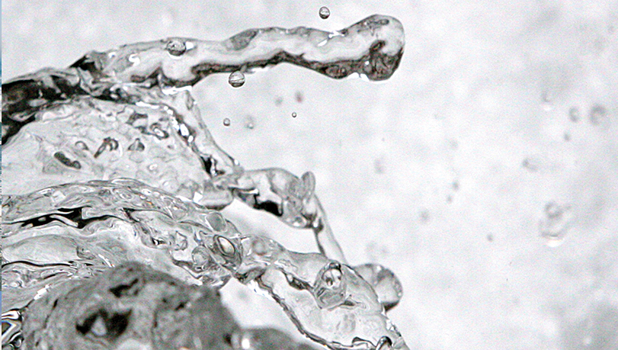
Water cycle
Cnes/Aviso
Notes:
Except otherwise noted, “Water cycle” presentation by Cnes/Aviso is licensed under CC BY-SA 4.0. To view a copy of this license, visit https://creativecommons.org/licenses/by-sa/4.0

Slide 2
A stable amount in Earth system
Water amount on (and within) Earth has been stable for at least 4 billion years.
Very few water comes in (a few asteroids, but including a very small amount of water, if not none at all) some water could have been brought by comets at the beginning of Earth, but 4 billions years ago (there may be water into the mantel, below the Earth crust)
Very few water leaves: Earth gravity field is strong enough to keep its atmosphere and water (opposite to Mars), and Earth magnetic field protects it from solar “winds”.
BUT: water is not staying at the same “place”, nor in the same state.
Notes:
Except otherwise noted, “Water cycle” presentation by Cnes/Aviso is licensed under CC BY-SA 4.0. To view a copy of this license, visit https://creativecommons.org/licenses/by-sa/4.0

Slide 3
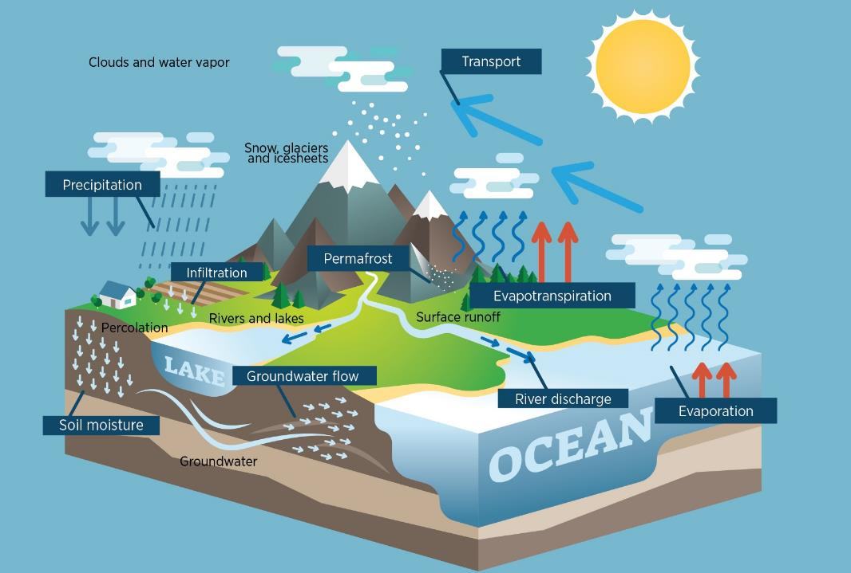
© Cnes/Mira Production
Notes:
Water cycle
Except otherwise noted, “Water cycle” presentation by Cnes/Aviso is licensed under CC BY-SA 4.0. To view a copy of this license, visit https://creativecommons.org/licenses/by-sa/4.0

Slide 4
Water cycle
The sun evaporates water in the form of water vapor (from the oceans, but not only: surface water, vegetation, ice...)
This water vapor rises into the atmosphere, where the air is colder. As a result, it condenses and forms clouds. These are moved by the winds.
Drops of water form in the clouds, and fall to Earth as precipitation (rain or snow).
Rain and melted snow run off. This feeds rivers, lakes and oceans.
Some of the water seeps into the ground.
If it is deep enough, the groundwater is recharged. The water stays there for a long time.
Near the surface, it is absorbed by plants or feeds rivers and lakes, and may flow to the surface as springs.
Water moves underground due to gravity and pressure. It can return to the oceans.
Notes:
Except otherwise noted, “Water cycle” presentation by Cnes/Aviso is licensed under CC BY-SA 4.0. To view a copy of this license, visit https://creativecommons.org/licenses/by-sa/4.0

Slide 5
Freshwater on lands
Where can we find freshwater on lands, and in what form is it?
Notes:
Except otherwise noted, “Water cycle” presentation by Cnes/Aviso is licensed under CC BY-SA 4.0. To view a copy of this license, visit https://creativecommons.org/licenses/by-sa/4.0

Slide 6
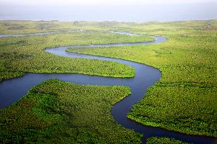
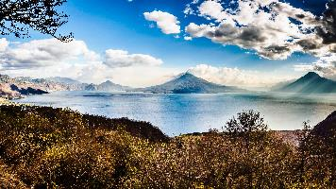
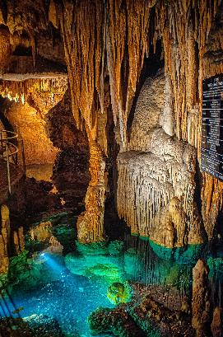
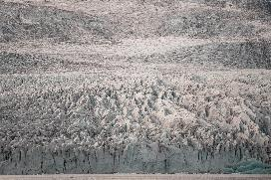
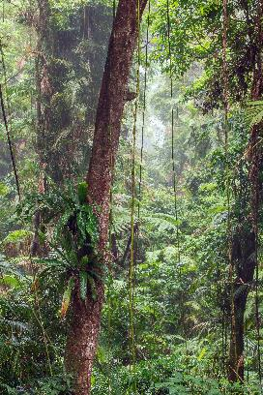
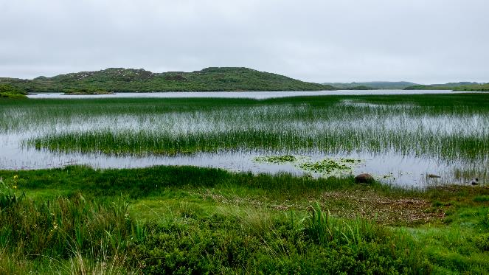
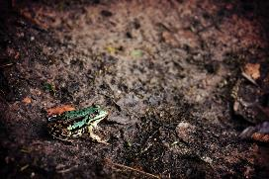
Freshwater “on” lands
rivers
lakes, reservoirs, ponds
groundwaters
glaciers, snow, polar caps, permafrost
Elias Vicario on Unsplash
Dan Roizer on Unsplash
Alexander Schimmeck on Unsplash
within vegetation
marshes, swamps, rice paddies
Robert Thiemann on Unsplash
into the soil itself
Gunnar Ridderstrom on Unsplash
Jill Heyer on Unsplash
David Clode on Unsplash
Notes:
Except otherwise noted, “Water cycle” presentation by Cnes/Aviso is licensed under CC BY-SA 4.0. To view a copy of this license, visit https://creativecommons.org/licenses/by-sa/4.0

Slide 7
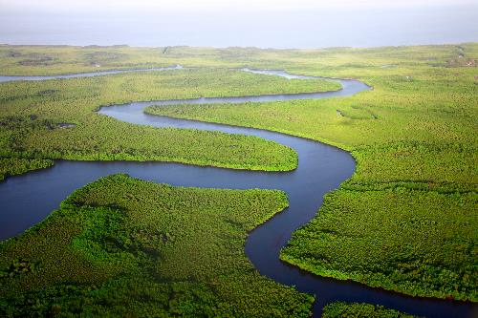
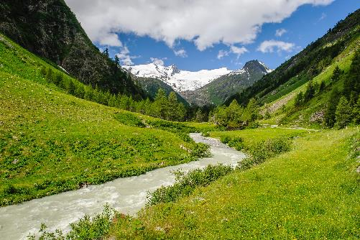
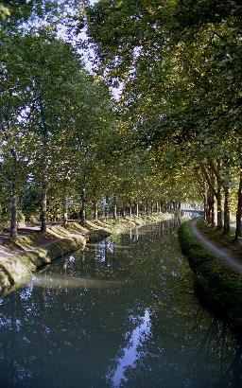
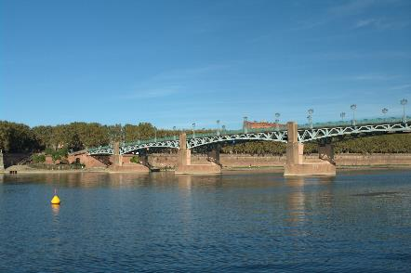
Running water: rivers, streams
Dan Roizer on Unsplash
Alexander Schimmeck on Unsplash
V.R.
V.R.
Notes:
Except otherwise noted, “Water cycle” presentation by Cnes/Aviso is licensed under CC BY-SA 4.0. To view a copy of this license, visit https://creativecommons.org/licenses/by-sa/4.0

Slide 8
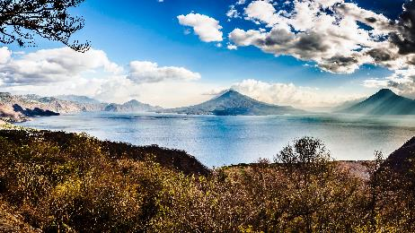
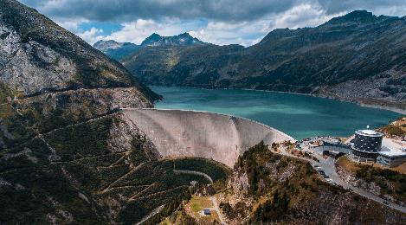
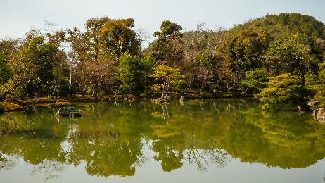
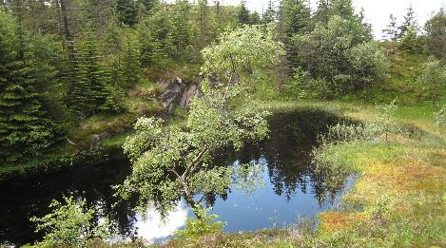
Still waters: lakes, reservoirs, ponds...
Alexander Schimmeck on Unsplash
Kees Streefkerk on Unsplash
Ice Tea on Unsplash
V.R.
Notes:
Except otherwise noted, “Water cycle” presentation by Cnes/Aviso is licensed under CC BY-SA 4.0. To view a copy of this license, visit https://creativecommons.org/licenses/by-sa/4.0

Slide 9
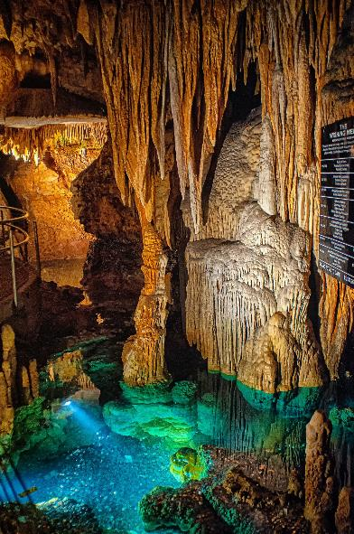
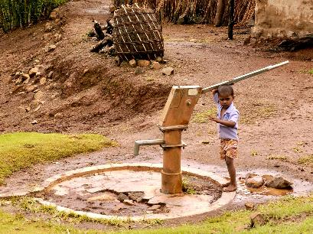
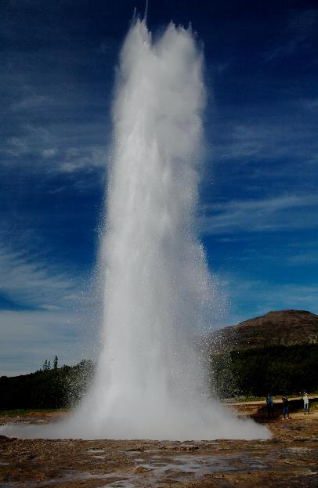
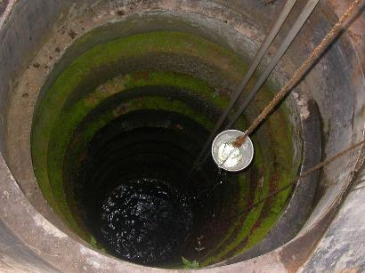
Groundwaters
Bradford Zak on Unsplash
Robert Thiemann on Unsplash
MANOJTV at the English-language Wikipedia
Paolo Chiabrando on Unsplash
Notes:
Except otherwise noted, “Water cycle” presentation by Cnes/Aviso is licensed under CC BY-SA 4.0. To view a copy of this license, visit https://creativecommons.org/licenses/by-sa/4.0

Slide 10
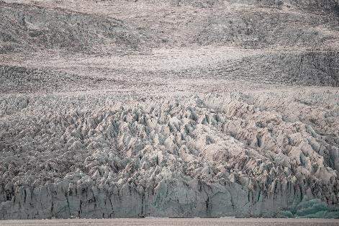
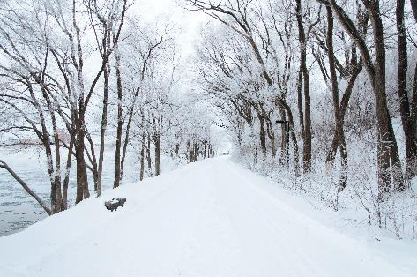
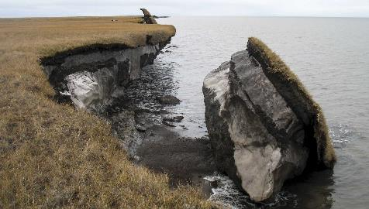
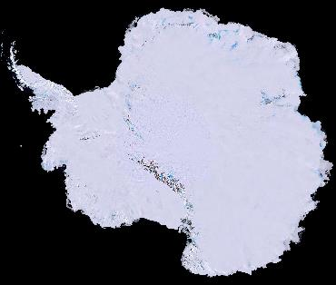
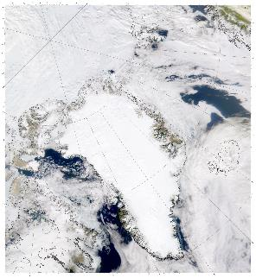
Frozen water: glaciers, snow, permafrost, polar caps
Elias Vicario on Unsplash
Ali Inay on Unsplash
USGS
Nasa
Nasa
Notes:
permafrost : water frozen within soil
Except otherwise noted, “Water cycle” presentation by Cnes/Aviso is licensed under CC BY-SA 4.0. To view a copy of this license, visit https://creativecommons.org/licenses/by-sa/4.0

Slide 11
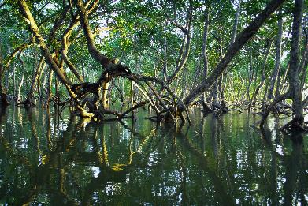
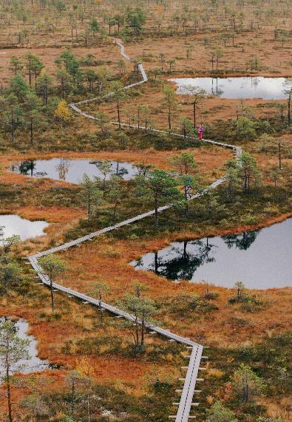
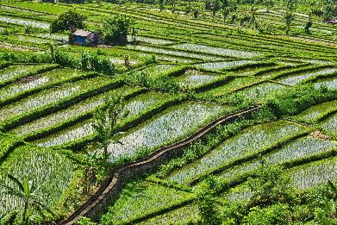
Stagnant waters: marshes, swamps, rice paddies,...
Timothy K. on Unsplash
Gunnar Ridderstrom on Unsplash
Steve Douglas on Unsplash
Siim Lukka on Unsplash
Notes:
Except otherwise noted, “Water cycle” presentation by Cnes/Aviso is licensed under CC BY-SA 4.0. To view a copy of this license, visit https://creativecommons.org/licenses/by-sa/4.0

Slide 12
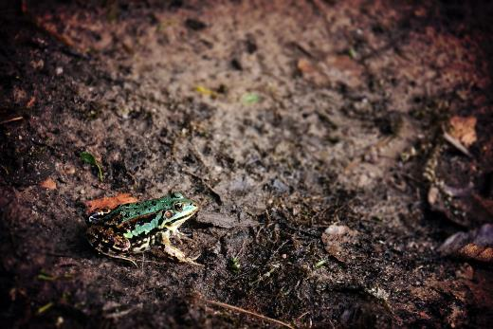
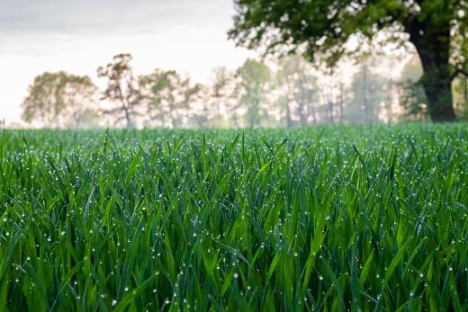
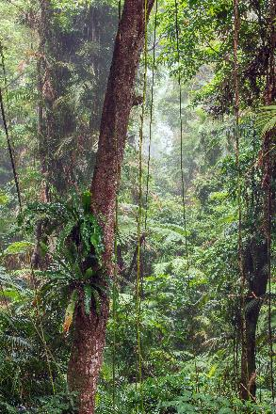
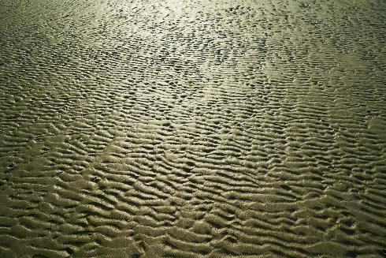
But also within soil and vegetation
Jill Heyer on Unsplash
Mateusz Stepien on Unsplash
Engin Akyurt on Unsplash
David Clode on Unsplash
Notes:
Except otherwise noted, “Water cycle” presentation by Cnes/Aviso is licensed under CC BY-SA 4.0. To view a copy of this license, visit https://creativecommons.org/licenses/by-sa/4.0

Slide 13
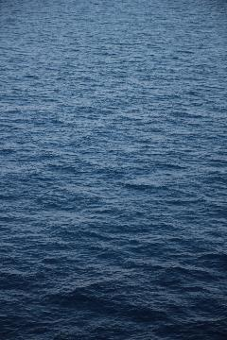
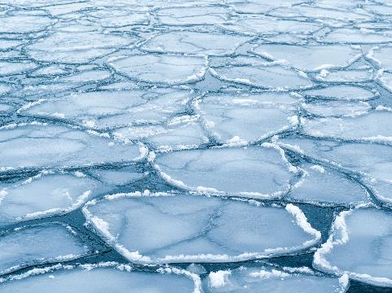
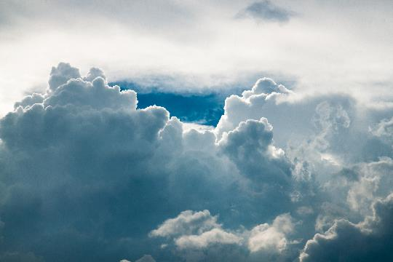
Don’t forget
Outside lands, there is also water in:
ocean (most of the water on the planet) – salted water
sea ice (ice pack) – frozen water gelée
atmosphere (clouds, but not only: air moisture…)
Jason Zeis on Unsplash
Tapio Haajai on Unsplash
Marc Wieland on Unsplash
Notes:
Except otherwise noted, “Water cycle” presentation by Cnes/Aviso is licensed under CC BY-SA 4.0. To view a copy of this license, visit https://creativecommons.org/licenses/by-sa/4.0

Slide 14
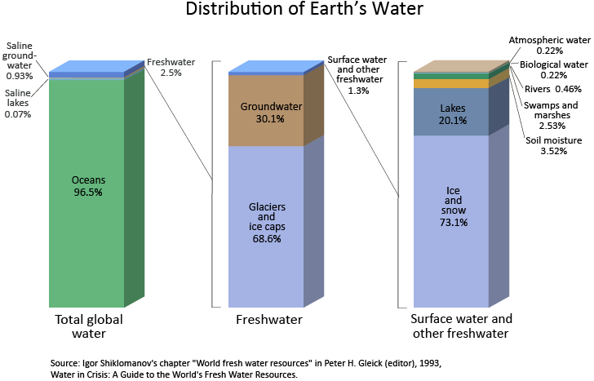
There is water on Earth, but…
Less than 3 % of Earth waters are fresh (not salted)
Less than 1% of Earth waters are fresh and liquid both (not salted nor frozen)
Only a small part of surface and underground waters can be used by human beings, as well as part of the precipitations (rain / snow).
Notes:
There is relatively few water on Earth, and very few which can be used by human beings.
Except otherwise noted, “Water cycle” presentation by Cnes/Aviso is licensed under CC BY-SA 4.0. To view a copy of this license, visit https://creativecommons.org/licenses/by-sa/4.0

Slide 15
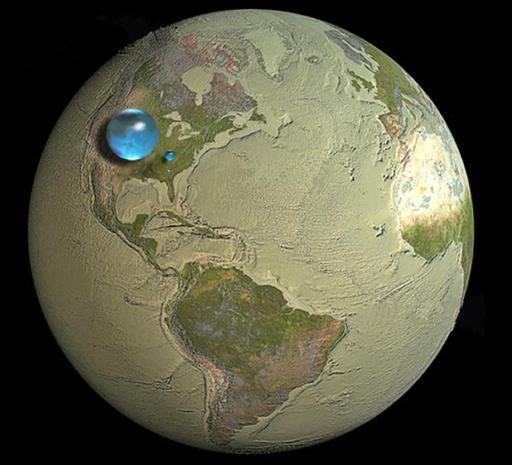
If the whole of Earth’s waters were together
It is mostly salted ( 97%)
Non-drinkable
Impossible to use to water fields
(out of expensive and energy- consuming treatments)
A small amount is fresh (less than 3% of the total amount) but this mostly frozen (more than 2% of the total amount)
Very few is in rivers or lakes (0,3%) or underground (less than 1%)
USGS
Notes:
Except otherwise noted, “Water cycle” presentation by Cnes/Aviso is licensed under CC BY-SA 4.0. To view a copy of this license, visit https://creativecommons.org/licenses/by-sa/4.0

